Slide 1

NEWS DATA ANALYSIS
By
ANKITA BONDRE

Slide 2
Abstract
Investigates trends and patterns within a dataset containing news articles from Reddit and Goperigon.
Dataset attributes include title, author, score, subreddit, number of comments, body, and creation timestamp.
Objective: Analyze user engagement, temporal trends, sentiment, and topics within the news articles.
Aim:
1. Understand the correlation between engagement metrics and article popularity.
2. Identify temporal trends and analyze sentiment evolution over time.
3.Uncover prevalent topics using topic modeling techniques.
Goal: Provide insights into user behavior, article popularity, and content trends.
Impact: Inform data-driven decisions to improve content strategies and user engagement on online platforms.

Slide 3
Project Architecture
Reddit
Data Preprocessing
API
Data Frame
Postgresql
Sql command
news_data
Goperigon
EDA &
Sentiment Analysis
Downloadable csv file

Slide 4
Project Objective
Explore User Engagement:
Objective: Analyze engagement metrics such as score and comments to understand user interaction patterns and identify factors influencing article popularity.
Approach: Examine the distribution of engagement metrics across articles to discern patterns and correlations.
Outcome: Insights into user behavior and factors driving article popularity.
Analyze Sentiment Dynamics:
Objective: Conduct sentiment analysis on news article titles to identify any shifts in public opinion or sentiment trends.
Approach: Utilize sentiment analysis techniques to quantify sentiment in article titles.
Outcome: Insights into sentiment trends and their impact on user engagement.
Uncover Prevalent Topics:
Objective: Utilize topic modeling techniques to uncover prevalent topics within the news articles dataset and identify key themes driving user engagement and interest.
Approach: Apply topic modeling algorithms to identify clusters of related words and themes within the dataset.
Outcome: Identification of key topics and themes driving user engagement and interest.

Slide 5
Data Integrity and Data Management
Collected news articles from various subreddits using the Reddit API.
Obtained news articles from Goperigon, a news website, by downloading the latest news files.
Stored collected data in Postgres database.

Slide 6
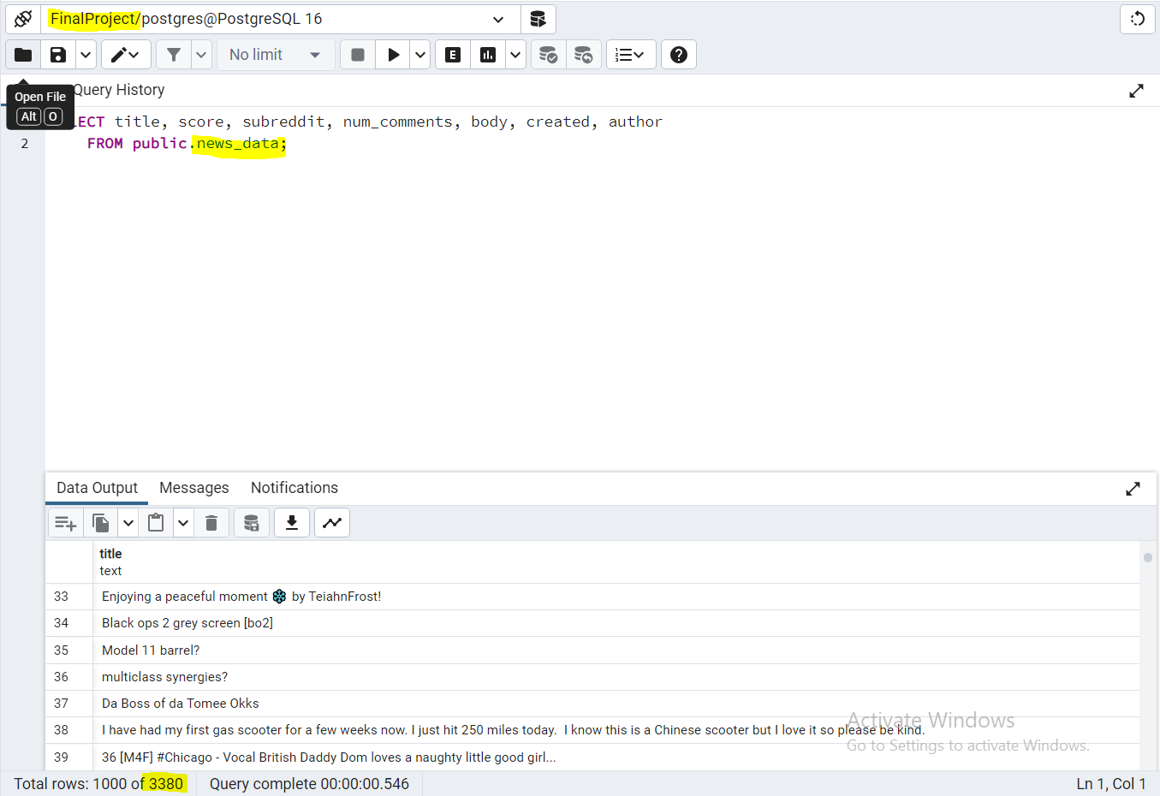
Postgres Database

Slide 7
EDA (Exploratory Data Analysis)
1. Null Value Analysis
2. Summary Statistics
2.1 Numerical Statistical Analysis
2.2 Categorical Statistical Analysis
3. Duplicate Value Analysis
4. Univariate Analysis
4.1 Categorical columns univariate analysis
4.2 Numerical columns univariate analysis
5. Bivariate Analysis
6. Multivariate Analysis
7. Feature Engineering
8. Sentiment Analysis and Topic Modeling

Slide 8
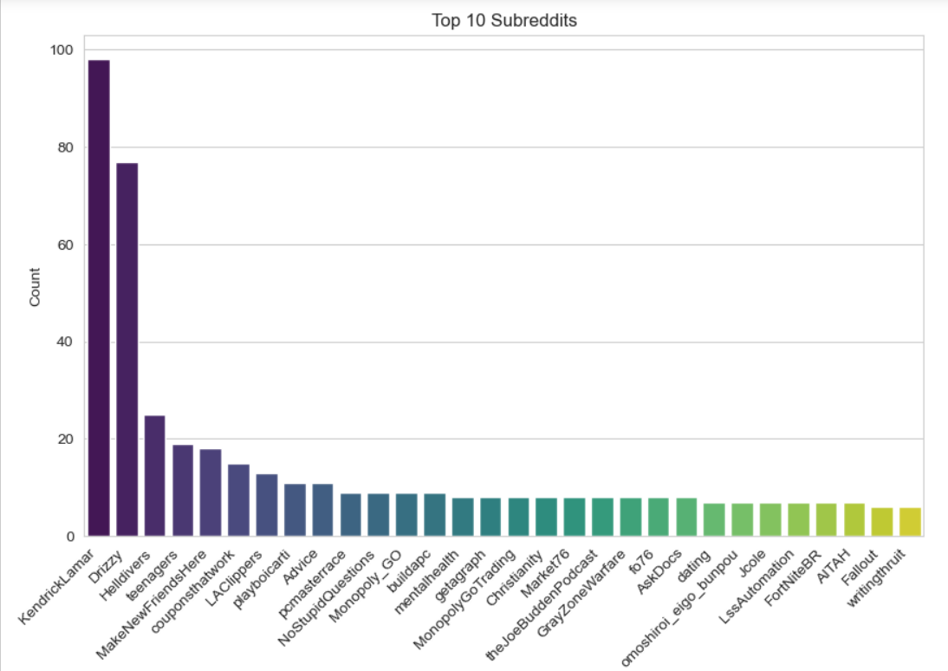
Univariate Analysis of Subreddit

Slide 9
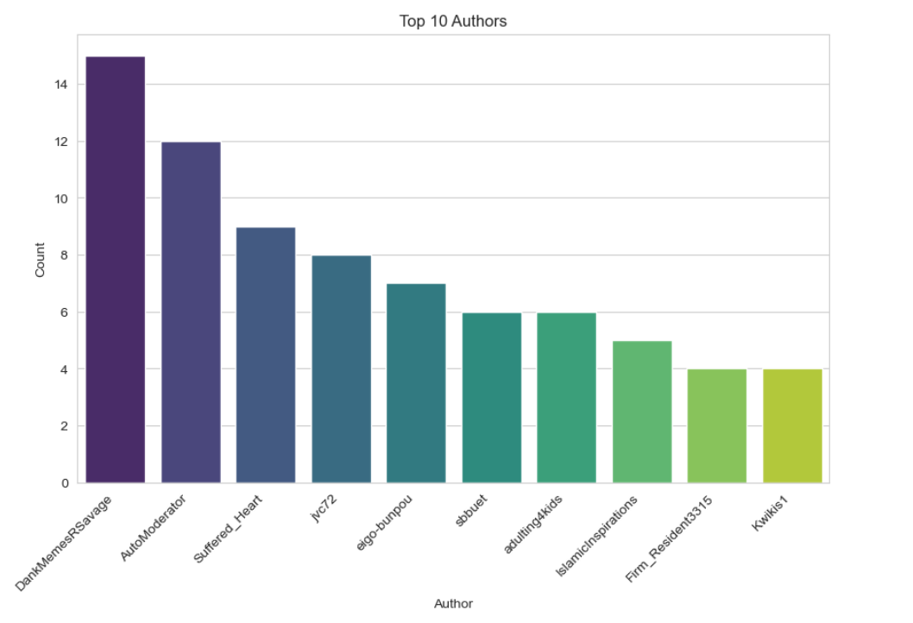
Univariate Analysis of Authors

Slide 10
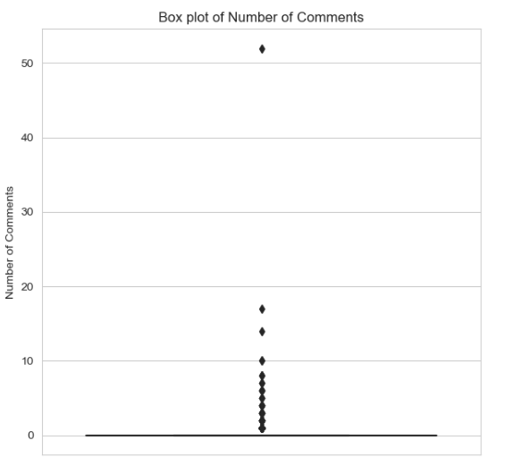
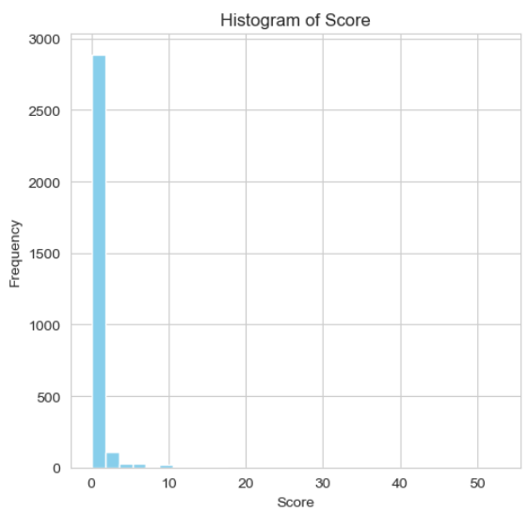
Univariate Analysis on Comments and Score

Slide 11
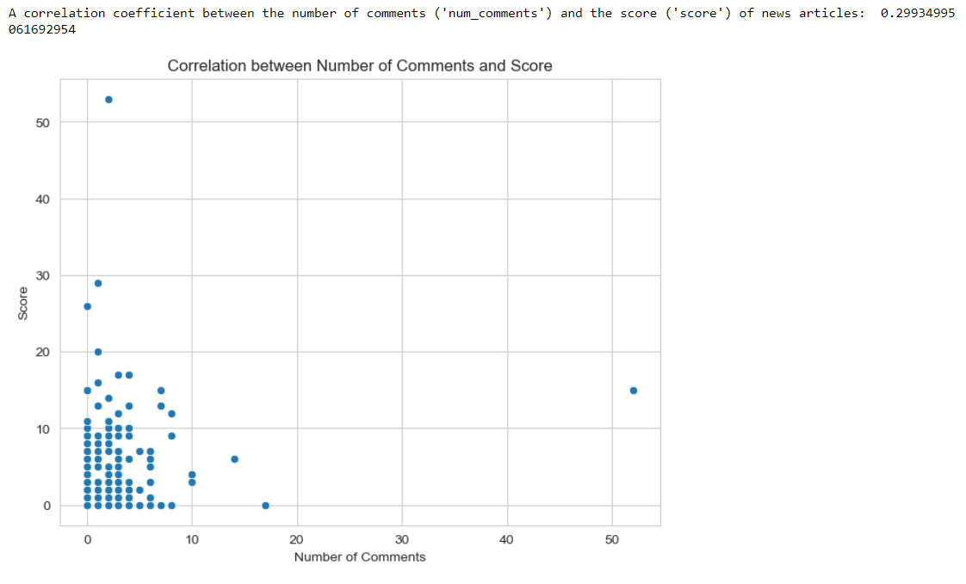
Correlation between No. of Comments and Score

Slide 12
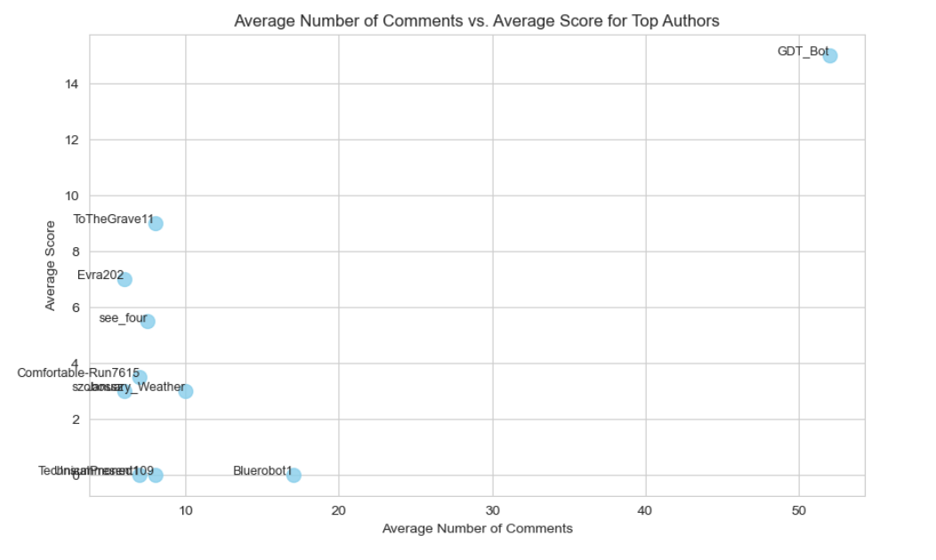
Post Engagement Analysis

Slide 13
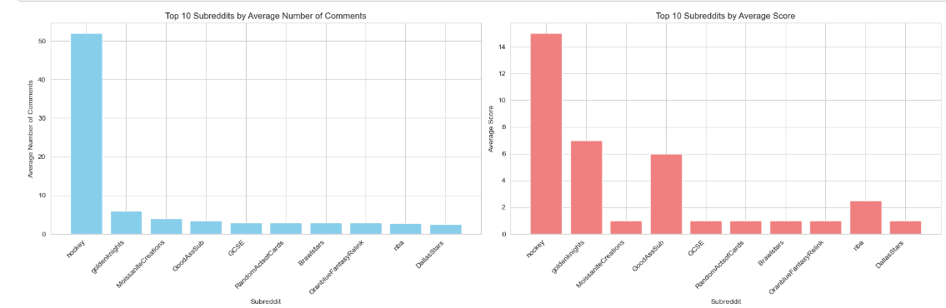
Top 10 Subreddits by Average Score and No. Of Comments

Slide 14
Feature Engineering
Feature Engineering Techniques Applied:
a. Title Length:
Description: Calculated the length of the title in characters.
Rationale: Longer titles might attract more attention or convey more information.
b. Body Word Count:
Description: Calculated the number of words in the body of the news articles.
Rationale: The length of the body might indicate the depth or complexity of the article's content.
c. Presence of Question Mark:
Description: Created a binary feature indicating whether the title contains a question mark.
Rationale: Titles with questions may engage readers more effectively.
d. Sentiment Analysis:
Description: Utilized sentiment analysis to assign a sentiment score to each news article.
Rationale: Understanding the sentiment of articles can provide insights into reader preferences and emotional engagement.

Slide 15
Sentiment Analysis
Analysis of LDA Topic Modeling Results
Optimal Number of Topics: 7
Topic 1: Seeking Help
Keywords: help, need, question, looking, please
Topic 2: User Engagement
Keywords: user, post, make, ask, sub.
Topic 3: Entertainment and Pop Culture
Keywords: Kendrick, drake, music, days, new
Topic 4: Technical Support
Keywords: anyone, new, pc, update, working
Topic 5: Music and Artists
Keywords: drake, Kendrick, music, daughter, happened
Topic 6: Technology and Coding
Keywords: code, anyone, daily, thanks
Topic 7: Personal Experiences and Advice
Keywords: first, time, job, meet, advice

Slide 16
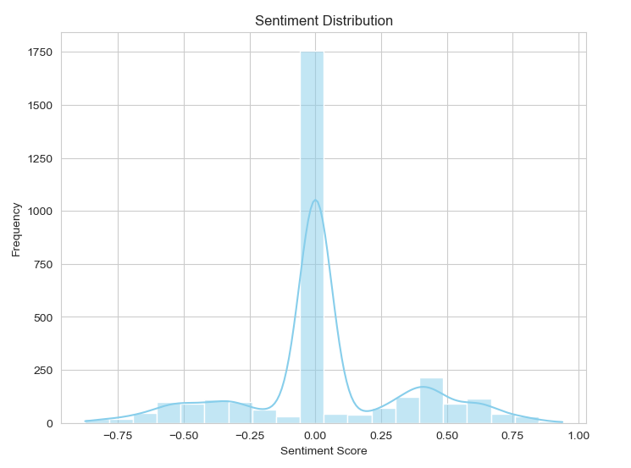
Sentiment Distribution
The sentiment distribution plot illustrates a balanced distribution of sentiment scores, centered around a central tendency of 0.
While the distribution leans slightly towards positive sentiment scores, as evidenced by the right skewness of the plot, it also displays a wide range of scores encompassing both positive and negative sentiments.

Slide 17
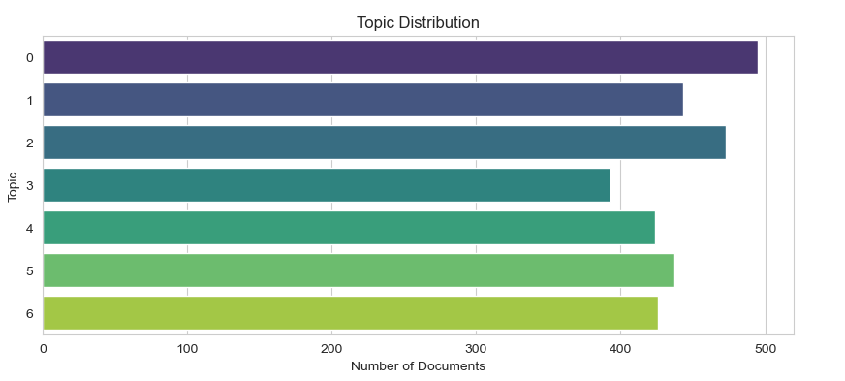
Topic Distribution
There is variation in the number of documents assigned to each topic, indicating an imbalance in topic distribution. For example, Topic 0 has the highest number of documents (495), while Topic 3 has the lowest number of documents (393).
Topics with higher document counts may receive more attention and scrutiny

Slide 18
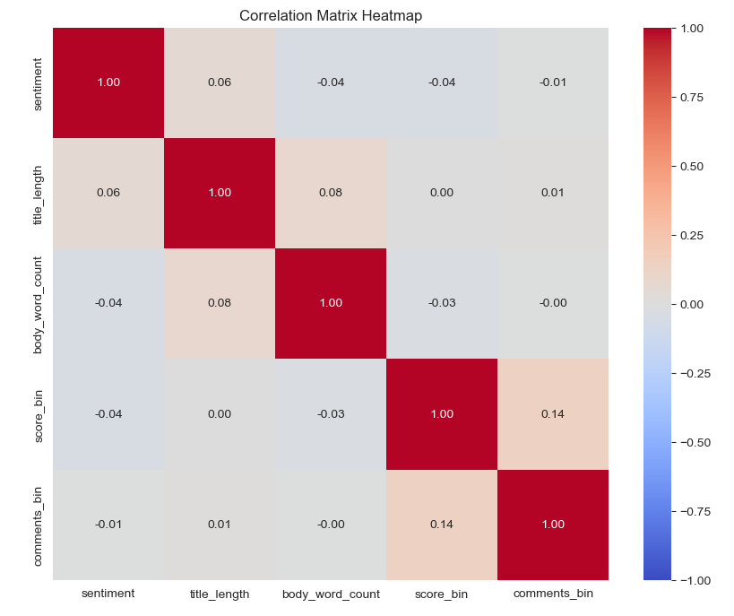
Sentiment analysis using correlation matrix
The correlation matrix shows weak associations between sentiment and other numerical features:
Weak positive correlation with title length (0.060024) and weak negative correlation with body word count (-0.044163).
Weak negative correlations with score bin (-0.043824) and comments bin (-0.007083), suggesting subtle influences.
Overall, sentiment appears minimally impacted by these variables, warranting further exploration

Slide 19
Challanges
Postgres Data Migration
News retrieval using Reddit API
Collecting dataset
Domain Knowledge regarding news dataset features

Slide 20
Conclusion
In this project, I delved into two primary areas: engagement and popular topics, and sentiment analysis and topic modeling. Here's a summary of my findings and conclusions:
Engagement and Popular Topics:
GDT_BOT emerged as the most engaging author, consistently generating significant interaction with its posts.
The "hockey" subreddit stood out as the most engaging community, fostering robust discussions and content appreciation.
Sentiment Analysis and Topic Modeling:
Leveraging sentiment analysis techniques like VADER, I uncovered nuanced sentiment trends within news articles. Despite a balanced sentiment distribution, fluctuations over time provided valuable insights into public opinion and reactions.
Topic modeling, particularly with LDA, revealed prevalent themes within news articles, aiding in understanding audience interests and preferences for content creation and strategy.
My analysis effectively utilized sentiment analysis and topic modeling techniques to gain insights into sentiment trends and prevalent themes within news articles.

Slide 21
Q & A

Slide 22
References
https://www.reddit.com/
https://www.goperigon.com/data-solutions/
https://www.geeksforgeeks.org/postgresql-connecting-to-the-database-using-python/
https://www.geeksforgeeks.org/ml-linear-discriminant-analysis/
https://towardsdatascience.com/feature-engineering-in-python-part-i-the-most-powerful-way-of-dealing-with-data-8e2447e7c69e

Slide 23
Source Code
Git Hub Link
https://github.com/ankita130698/AIM-5001-/blob/main/Ankita_Bondre_FInalProject.ipynb

Slide 24
THANK YOU

